Slide 1

TITLE: Design of a personalized smart remainder system utilizing IOT –Enabled device and machine learning for efficient routine management.
Team Details:
Names:
Ajith T / 211423104019
Abishek G/211423104007
Aaron Winston A /211423104002
Batch Number: L5
Domain: Machine Learning & IOT
Guide Name & Designation
Dr.A.Hemlathadhevi Professor

Slide 2

SDGs and TARGETs
Primary Goal No: 9 - Industry, Innovation and Infrastructure
Target SMART REMAINDER uses simple, affordable tech to build user-friendly detection
infrastructure. It improves daily reliability and accessibility without the need for complex systems.
2. Secondary Goal No: 11- Sustainable Cities and Communities
Target Your project minimizes waste by preventing unnecessary repurchasing of lost items. This contributes to cleaner cities and more responsible urban consumption.
Tertiary Goal No: 12 Responsible Consumption and Production
Target SMART REMAINDER supports safer, more efficient urban mobility by helping commuters
avoid loss. It complements public transport systems by reducing stress and improving travel
preparedness.

Slide 3

Problem Statement
People often forget personal items like phones or wallets after leaving seats or vehicles.
This leads to inconvenience, stress, and potential theft.
3.Most current solutions rely on memory or manual checks.
4.There's a need for a smart system that detects forgotten items and instantly alerts the user.

Slide 4
Pressure Sensor: Detects item presence through applied weight or force.
Abstract
SMART REMAINDER is a low-cost IoT solution that uses pressure sensors and a buzzer to alert users when items are forgotten or misplaced.
It prevents item loss and enhances accountability through real-time alerts triggered by sensor feedback.
The system encourages responsible usage and reduces everyday forgetfulness, minimizing unnecessary waste
It supports Sustainable Development Goals: SDG 9 (Innovation & Infrastructure), SDG 11 (Sustainable Cities), and SDG 12 (Responsible Consumption).
The design is simple, compact, and user-friendly, making it ideal for homes, offices, schools, and public places.
Its functionality is scalable, allowing expansion into larger smart systems like logistics, smart transport, and inventory tracking.
SMART REMAINDER bridges human behavior and smart living, promoting sustainable and mindful lifestyles.

Slide 5
Research and Literature Review
1. Development of Smart Alerting System using Real Time Object Detection with Deep Learning
Category | Details
Authors | (Not explicitly listed in PDF preview) Likely final-year undergraduates and advisor from IRJET-affiliated institution. Focuses on embedded real-time image processing research using YOLO + OpenCV.
Summary | Proposes a real-time object detection system (colored bulbs) using YOLO on embedded UNIX systems. Tracks objects, memory conditions, and transmits datagrams via UDP. (irjet.net)
Relevance | Demonstrates democratization of CV tech using affordable embedded hardware. Applicable to real-time monitoring in surveillance, robotics, manufacturing. (irjet.net)
Gap | Focuses only on colored bulb detection—limited object scope and complexities. Doesn’t tackle robustness in varied environments or large-scale object classes. (irjet.net)
Impact | Enables low-cost, networked IoT vision systems for alerts and automation. Lays groundwork for further development in affordable real-time embedded CV. (irjet.net)

Slide 6
Research and Literature Review
2.
Smart Shopping Basket using Object Detection and Load Cell
Category | Details
Authors | Bhanu Keerthan S, Divya H E, Vikas Muthyal M, Y Yugandhar, Prof. Vidya H A from Sai Vidya Institute of Technology, Bengaluru. Final-year ISE students guided by their assistant professor for this smart shopping innovation.
Summary | The paper proposes a smart shopping basket that uses object detection and load cells to automate billing. It provides real-time tracking of items and cost, reducing the need for manual checkout.
Relevance | Highly relevant in today’s retail environment aiming for contactless, fast, and efficient shopping. It fits into the growing trend of smart retail and automation using IoT and AI.
Gap | The system may lack the accuracy of barcode scanning and faces challenges in real-time object recognition. Further improvement is needed in object detection precision and error handling.
Impact | It can transform retail shopping by minimizing checkout time and human errors. In the long run, it promotes fully automated, cashier-less retail environments.

Slide 7
Research and Literature Review
3. IJESRT – International Journal of Engineering Sciences & Research Technology
Category | Details
Authors | Typically feature undergraduate/graduate student teams guided by faculty from engineering colleges. Papers often involve practical projects in IoT, embedded systems, and sensor-based automation. (IJSETR)
Summary | Publishes implementations of low-cost embedded systems such as ARM- or Arduino-based sensor networks. Covers real-time detection using sensors like ultrasonic, gas, vibration alongside buzzers. (IJSETR, studylib.net)
Relevance | Aligns with SMART REMAINDER’s architecture: sensor-triggered alerts using pressure sensors and buzzers. Emphasizes affordability, accessibility, and hands-on IoT deployment. (IJSETR, studylib.net)
Gap | Many published works in IJESRT focus on broader monitoring (accident detection, gas leakage) rather than item-loss prevention. Limited examples specifically using pressure-based alert alerts or consumer-use scenarios. (IJSETR, studylib.net)
Impact | Demonstrates how student-led embedded IoT projects can deliver real-world functionality. Provides a credible peer-reviewed outlet for innovations like SMART REMAINDER and similar sensor‑alert systems. (IJSETR, studylib.net)

Slide 8
Research and Literature Review
4. IoT-Based Vehicle Occupant Detection and Alert System for Child and Pet Safety
Category | Details
Authors | Hagar H. N. Morsy, Shaima J. Ali Alhammadi, Khawla S. A. Albastaki, Noor ul Misbah Khanum, and Anwar Jarndal from the Electrical Engineering Department, University of Sharjah, Sharjah, United Arab Emirates.
Summary | Proposes an IoT-based real-time monitoring and alert system to detect children or pets left unattended in vehicles. Utilizes a combination of sensors (temperature, motion, weight, etc.), microcontrollers, and wireless communication to send alerts to guardians or emergency services. The system aims to prevent fatalities due to vehicular heatstroke.
Relevance | Addresses a critical safety concern—accidental deaths of children and pets in parked vehicles. Leverages cost-effective IoT technologies to implement a scalable and life-saving solution. Applicable in regions with high ambient temperatures.
Gap | Limited testing in diverse climatic conditions and vehicle types. Depends on sensor calibration accuracy and may not account for false positives (e.g., inanimate objects mimicking body weight). Requires stable internet/mobile connectivity for full functionality.
Impact | Supports development of smart vehicle safety systems. Encourages integration of affordable IoT-based safety modules in commercial vehicles. Can influence public policy and automotive manufacturing standards for occupant safety.

Slide 9
5. Pressure Sensor Array-Camera Based Activity Level Monitoring at Home: A Feasibility Study
Category | Details
Authors | Anil Kumar Appukuttan Nair Syamala Amma, Srinjoy Mitra (School of Engineering, University of Edinburgh, UK), Longfei Chen, and Robert B. Fisher (School of Informatics, University of Edinburgh, UK).
Summary | This study presents a hybrid home activity monitoring system combining a pressure sensor array with a camera module to estimate occupant activity levels. The system captures pressure-based footstep data and synchronizes it with visual activity detection to provide accurate real-time home monitoring, aiming to support elderly care and remote health assessment.
Relevance | Relevant in the context of aging populations and healthcare digitization. Offers a privacy-conscious alternative to camera-only surveillance by fusing non-intrusive sensor data. Useful in smart homes, elderly support systems, and health-tech applications.
Gap | Currently a feasibility study with limited deployment and subject diversity. Needs further validation under long-term, real-world conditions. May face challenges in multi-occupant scenarios and in homes with pets or irregular foot traffic.
Impact | Lays the foundation for multi-modal, unobtrusive health monitoring systems. Encourages adoption of hybrid sensor-CV models in smart healthcare. Can aid clinicians and caregivers in behavior pattern analysis for chronic care or emergency intervention.

Slide 10
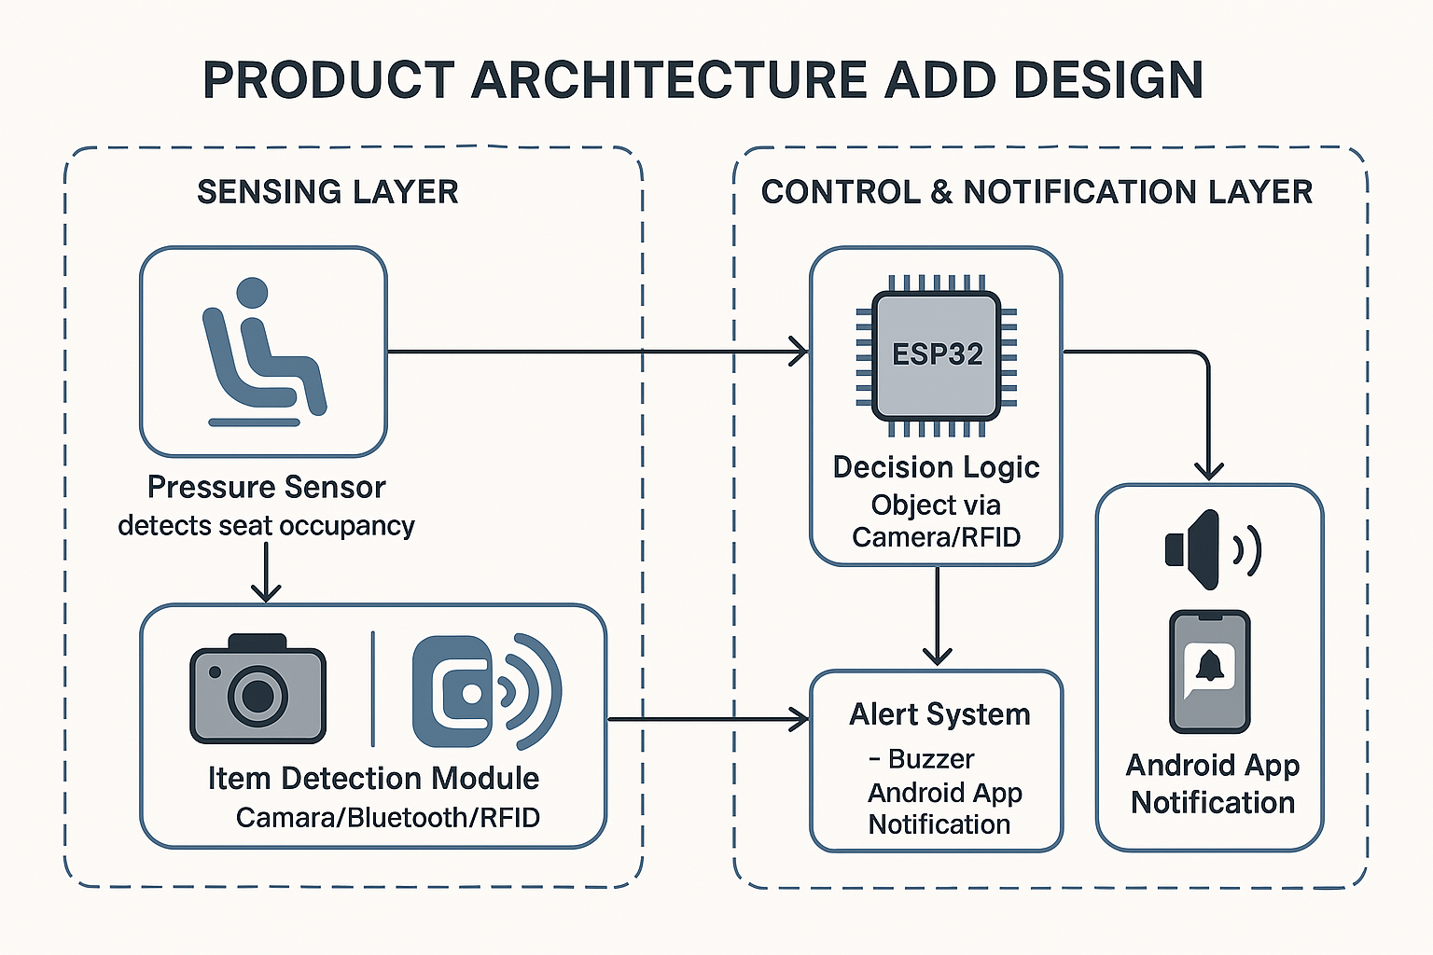
Product Architecture and Design/ Block Diagram

Slide 11
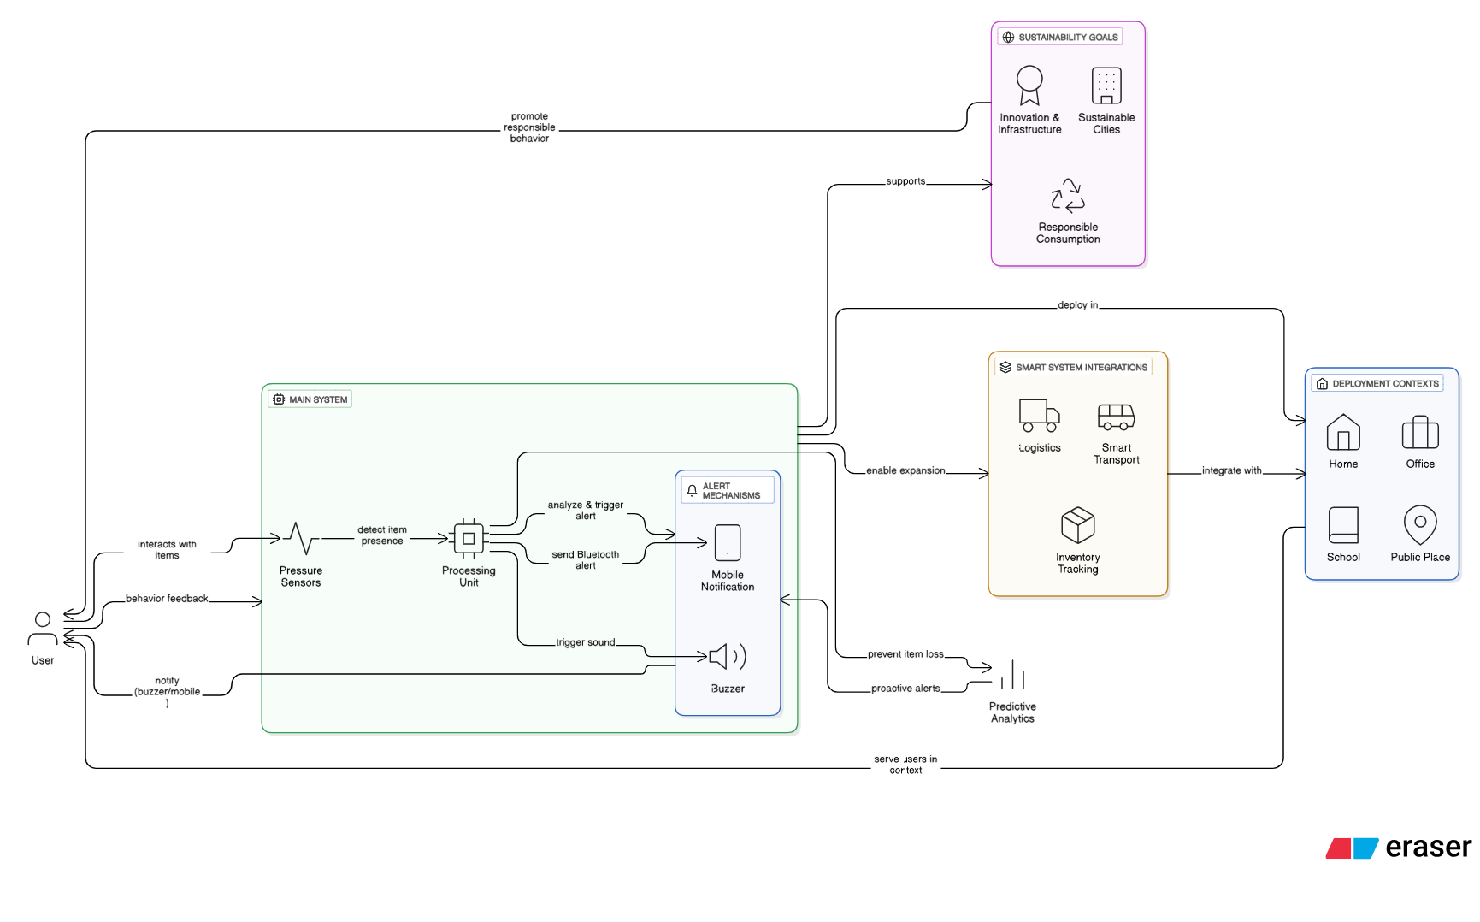

Slide 12
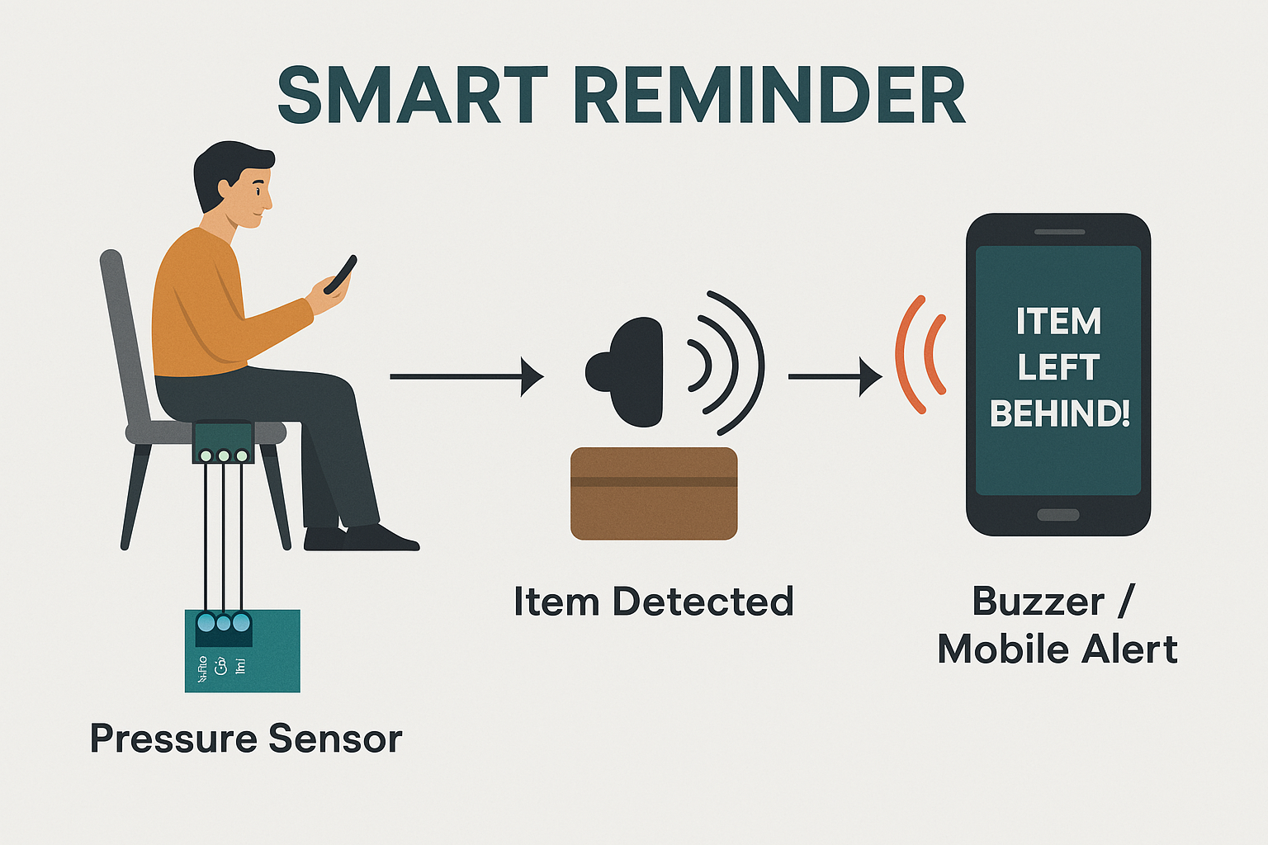

Slide 13
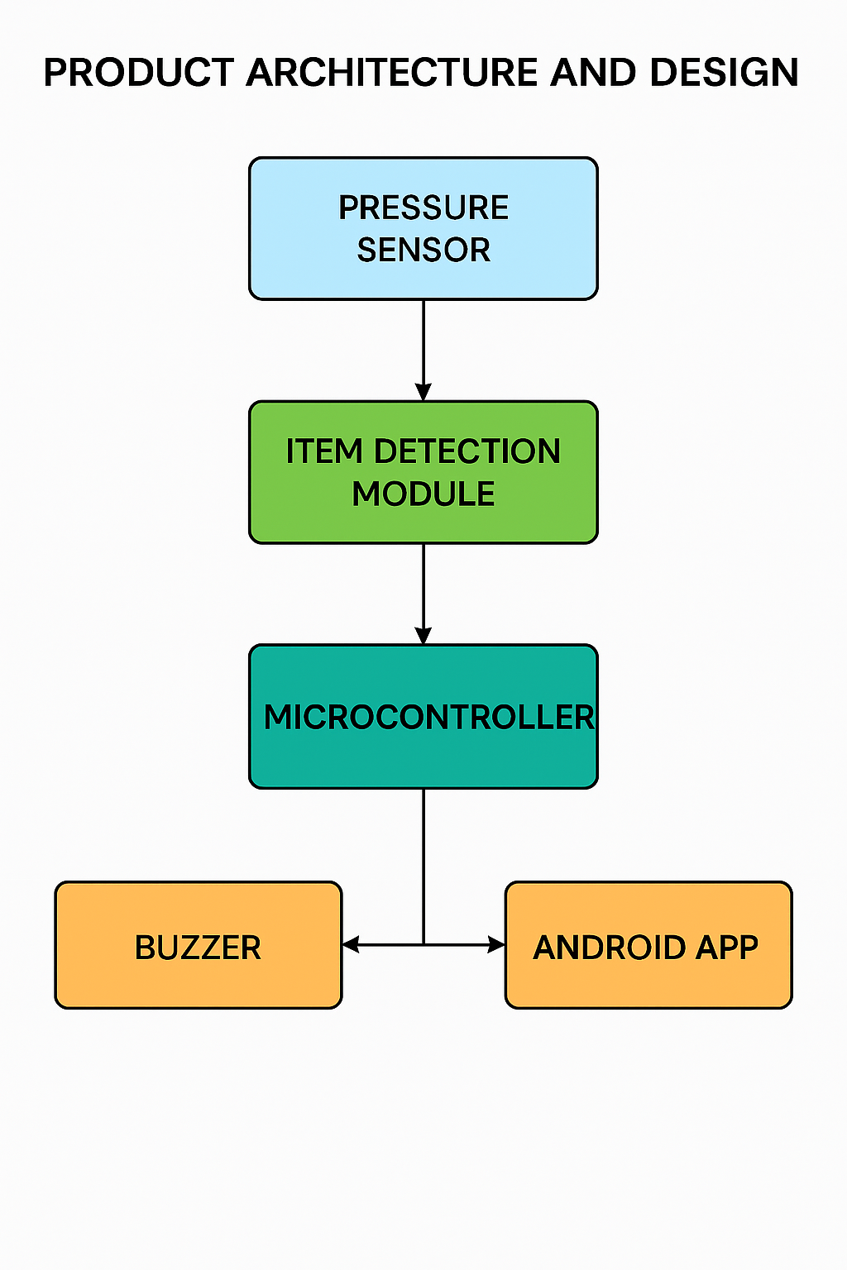
TARGET AREA’s
Transport Vehicle’s like Train, Bus, Bike etc..
Even this setup possible in office’s table and personel tables

Slide 14
Thank You

